Slide 1
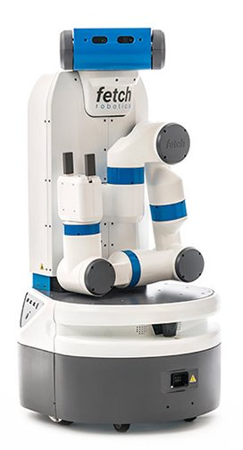
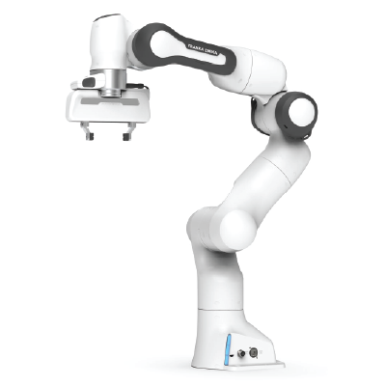

Learning for Interactive Robots Lifelong Robot Library Learning: Bootstrapping Composable and Generalizable Skills for Embodied Control with Language Models
Presenter: Tyler Kim

Slide 2
Overview
Overview of Paper
Background Knowledge
How LRLL works?
Experimental Results
Strengths
Weaknesses
Extensions

Slide 3
I. Overview of Paper

Slide 4
Overview of Paper
Authors: Georgios Tziafas and Hamidreza Kasaei
Motivation: LLMs for generating policy code limit agent to stationary range of addressable tasks
Contributions:
Lifelong Robot Library Learning (LRLL): LLM that grows robot skill library
Dynamic storage and retrieval of past experiences to serve as context
Self-guided exploration policy
Distills recent experiences into new skills
Learn new skills with minimal human online interaction
Bypasses
Model finetuning
Gradient-based optimization

Slide 5
II. Background Knowledge

Slide 6
II. Background Knowledge
Machine Learning: computer systems that can learn and adapt without being explicitly trained
Finetuning: process of finding the best value for nontrainable parameters
Gradient-based optimization: the use of gradients to optimize an objective function
Large Language Models (LLM): a type of machine learning algorithm that generates natural language and others
General
Abstract Syntax Tree (AST): a tree representation of code
Cluster: a group of objects that are similar to each other
Chain-of-thought: process of approaching a task step-by-step

Slide 7
III. How LRLL Works?

Slide 8
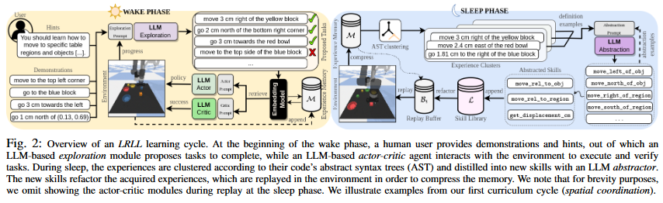
III. How LRLL works?
Lifelong Robot Library Learning or LRLL
Image taken from figure 2 from Tziafas and Kasaei
Wake-Sleep Cycle
Wake: agents interact with environment and users to grow experience
Sleep: agent reflects on experience to expand capabilities

Slide 9
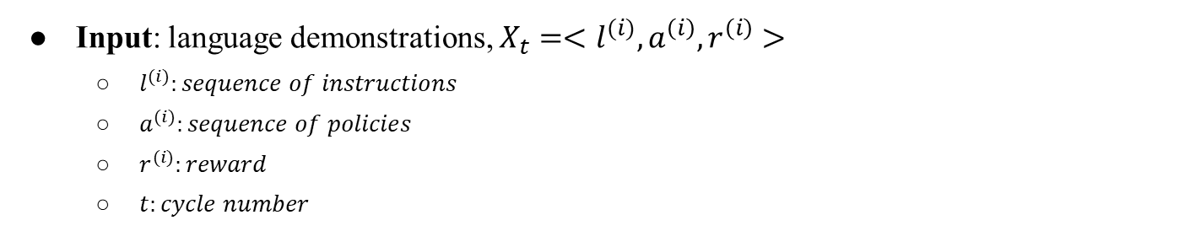
II. How LRLL works?
Image taken from figure 2 from Tziafas and Kasaei
Input: language demonstrations, $X_{t}=<l^{(i)}, a^{\left(i\right)}, r^{\left(i\right)}>$
$l^{(i)}:sequence of instructions$
$a^{(i)}:sequence of policies$
$r^{(i)}:reward$
$t:cycle number$

Slide 10
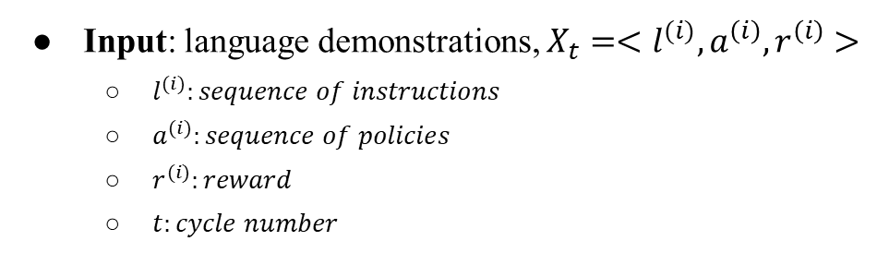
II. How LRLL works?
Image taken from figure 2 from Tziafas and Kasaei
Input: language demonstrations, $X_{t}=<l^{(i)}, a^{\left(i\right)}, r^{\left(i\right)}>$
$l^{(i)}:sequence of instructions$
$a^{(i)}:sequence of policies$
$r^{(i)}:reward$
$t:cycle number$
memory

Slide 11
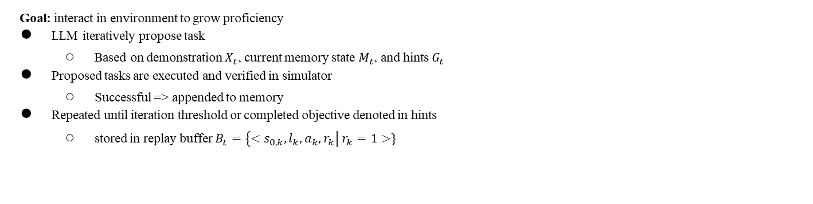
II. How LRLL works?
Wake Phase
Image taken from figure 2 from Tziafas and Kasaei
Goal: interact in environment to grow proficiency
LLM iteratively propose task
Based on demonstration $X_{t}$, current memory state $M_{t}$, and hints $G_{t}$
Proposed tasks are executed and verified in simulator
Successful => appended to memory
Repeated until iteration threshold or completed objective denoted in hints
stored in replay buffer $B_{t}=\left\{<s_{0,k}, l_{k}, a_{k}, r_{k}\right| r_{k}=1>\}$

Slide 12
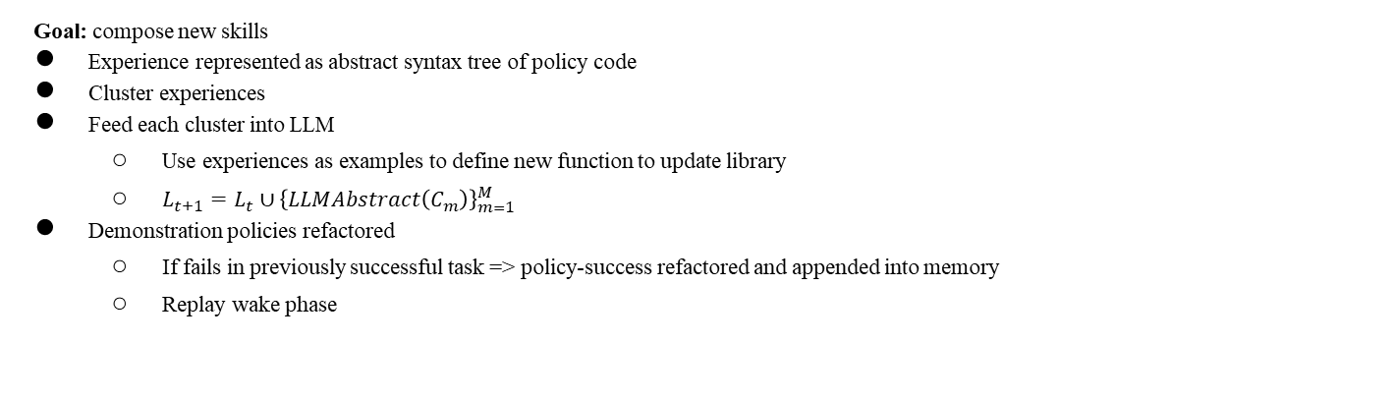
II. How LRLL works?
Sleep Phase
Image taken from figure 2 from Tziafas and Kasaei
Goal: compose new skills
Experience represented as abstract syntax tree of policy code
Cluster experiences
Feed each cluster into LLM
Use experiences as examples to define new function to update library
$L_{t+1}=L_{t}∪{\left\{LLMAbstract\left(C_{m}\right)\right\}}_{m=1}^{M}$
Demonstration policies refactored
If fails in previously successful task => policy-success refactored and appended into memory
Replay wake phase

Slide 13
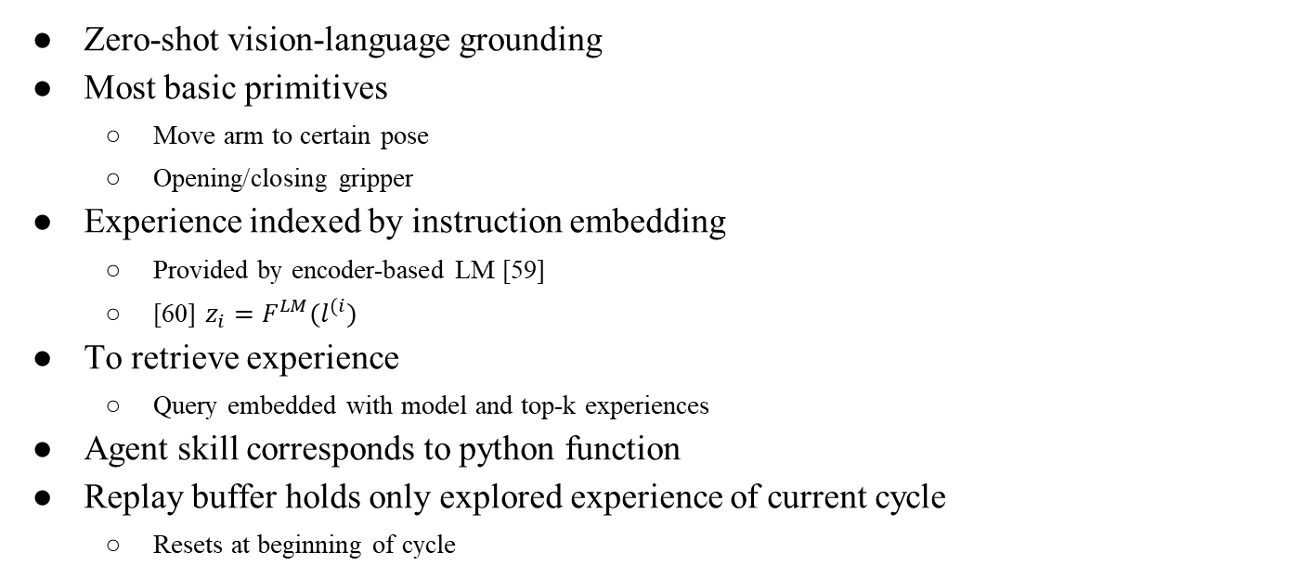
III. How LRLL works?
Zero-shot vision-language grounding
Most basic primitives
Move arm to certain pose
Opening/closing gripper
Experience indexed by instruction embedding
Provided by encoder-based LM [59]
[60] $z_{i}=F^{LM}(l^{(i})$
To retrieve experience
Query embedded with model and top-k experiences
Agent skill corresponds to python function
Replay buffer holds only explored experience of current cycle
Resets at beginning of cycle

Slide 14
III. How LRLL works?
LLM Prompts
Comment describing general purpose
API information
Sequence of task-code pairs from retrieved experiences
Chain-of-thoughts provided as comments
Exploration
Variations: alter concepts present in instruction
Compositions: combinations of concepts present in demos
Skill Abstraction
Maintain logic but account for variations
Extract boilerplate snippets and abstract them to new functions

Slide 15
IV. Experimental Results

Slide 16
IV. Experimental Results
gpt-3.5-turbo and text-embedding-ada-002
blocks-and-bowls setup replicated from previous works
41 task templates and 4 cycles
Spatial coordination
Visual reasoning
Object manipulation
rearrangement
Task instances
Seen instructions with seen (SA)/unseen (UA) attributes
Unseen instructions with unseen attributes (UI)
For lifelong setup
Forward-transfer
Backward-transfer
Baselines
CLIPort
CaP
LLRL-no-sleep
LLRL-no-wake

Slide 17
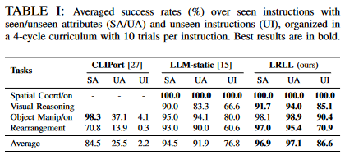
IV. Experimental Results
Tabletop Manipulation
Simulated teacher
Generated 5 demonstrations
Multiple test for each cycle
CLIPort
1k trajectories per task
LLM-static
Demos append to prompt
Image taken from Table I of paper

Slide 18
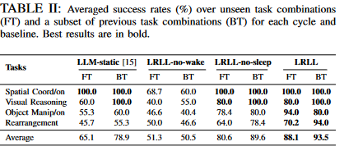
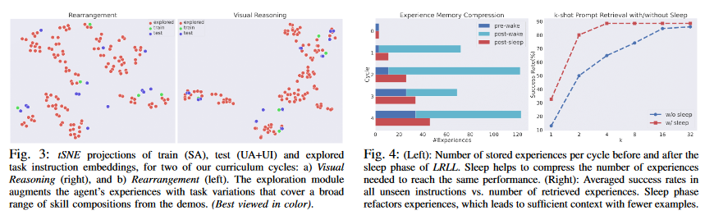
IV. Experimental Results
Ablation
Image taken from Table 2 of paper
Image taken from figures 3 and 4

Slide 19
V. Strengths

Slide 20
V. Strengths
Excellent at learning new
Memory efficient
Dynamically learn skills for increasing complex situations
Minimal expert intervention
Scalability in learning new skills

Slide 21
VI. Weaknesses

Slide 22
VI. Weaknesses
Limited by choice of vision API
Limited scalability to skills that can be expressed symbolically
Refining initial prompts to exploration/abstraction modules when changing domains or LLM engines
Latency and price

Slide 23
VII. Extensions

Slide 24
VII. Extensions
Authors want investigate gap between GPT and other alternatives
What applications could LRLL have in a more complicated end-effector such as a humanoid hand?
How would a multimodal input affect the number of new skills that LRLL robot could learn?
What are other ways that LRLL can explore and propose different tasks?

